Slide 1
Library Management Service
OOP1 Assignment Report
Author: Joel Silva (A00336679)

Slide 2

Project Overview and Requirements
The Library Management Service is a REST API focused on managing loans, members, and library items
Demonstrate the practical application of fundamental OOP principles (Inheritance, Polymorphism, Encapsulation) and advanced Java features (Records, Sealed Classes, Lambdas)
Demonstrate Java 25 features (Flexible Constructor Bodies and Instance Main Methods)

Slide 3
System Architecture
The application adopts a standard three-tier architecture
Controller
calls
Service
uses
Repository
accesses
In-Memory
Storage
store/retrieves
Data In Memory
Static Maps

Slide 4
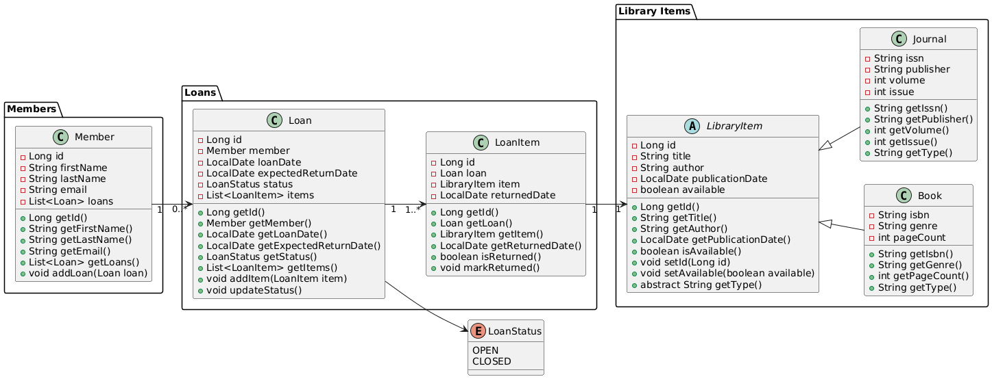
Domain Model

Slide 5
Core OOP Principles
Encapsulation
Achieved by declaring all fields as private. Access is provided through controlled public getter and setter methods to safeguard the internal state
Polymorphism
Demonstrated via abstract getType() method in LibraryItem. This method is overridden in Book and Journal to return “BOOK” or “JOURNAL”, allowing the service layer to process all items uniformly as LibraryItem references
Interfaces
The LoanService interface defines the business contracts, promoting flexibility and testability

Slide 6
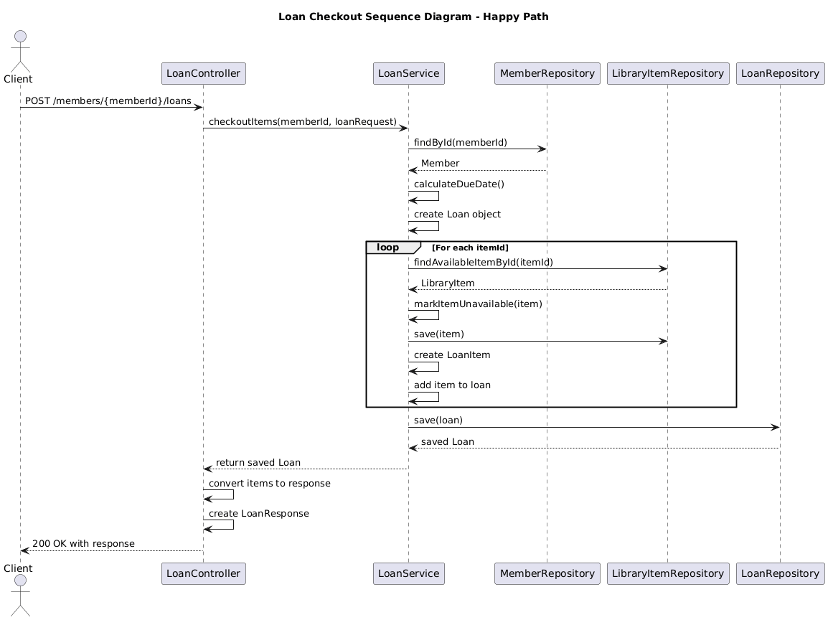
User Stories and API Endpoints
Borrow books or journals
POST /v1/members/{memberId}/loans

Slide 7
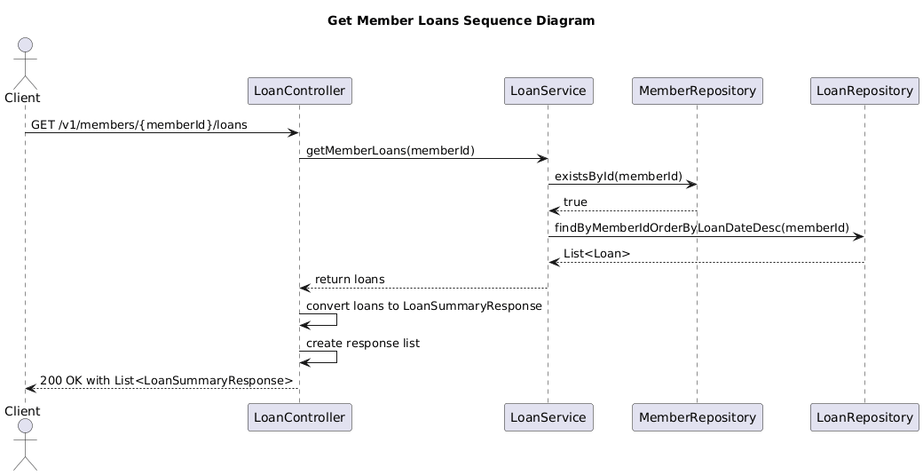
User Stories and API Endpoints
List all Loans
GET /v1/members/{memberId}/loans

Slide 8
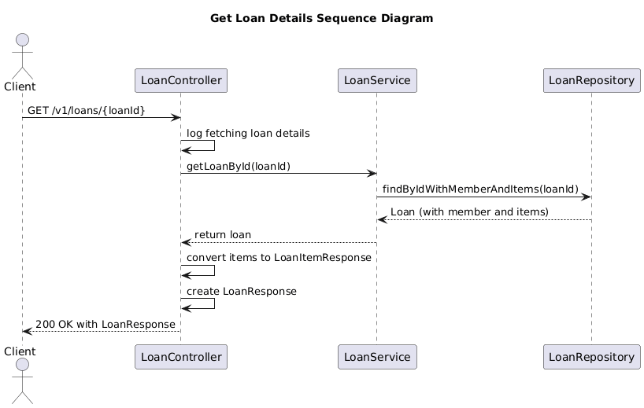
User Stories and API Endpoints
Retrieve Loan by ID
GET
/v1/loans/{loanId}

Slide 9
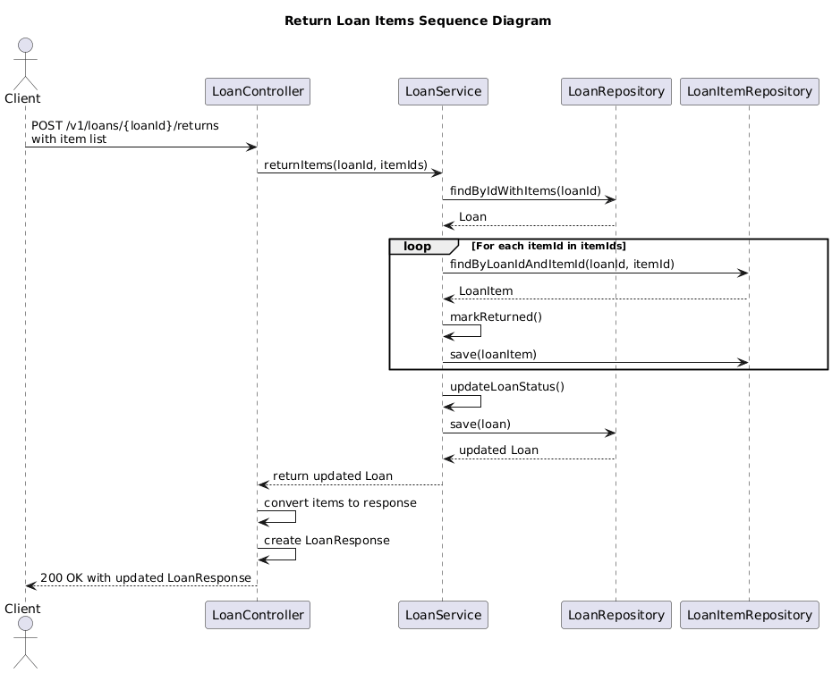
User Stories and API Endpoints
Return Loan Items
POST
/v1/loans/{loanId}/returns

Slide 10
Exception Handling
Exception Strategy
Uses custom unchecked exceptions ItemNotFoundException, ItemNotAvailableException to signal business rule violations in the Service Layer
Centralized Handler
A GlobalExceptionHandler (@ControllerAdvice) handles all custom exceptions, guaranteeing consistent, structured JSON error responses with correct HTTP status codes (e.g., 404 NOT FOUND)

Slide 11
DEMO

Slide 12
Advanced Java Features
Records & Immutability
Java Records are utilized for defining lightweight, immutable Data Transfer Objects (DTOs), such as LoanResponse
public record LoanResponse(
Long id,
Long memberId,
LocalDate loanDate,
LocalDate expectedReturnDate,
List<LoanItemResponse> items,
String status
) {}

Slide 13
Advanced Java Features
Defensive Copying
Implemented to safeguard internal state of objects containing mutable collections. Getter methods for lists return an unmodifiable view or copy to prevent external modification.
public List<LoanItem> getItems() {
return List.copyOf(items);
}

Slide 14
Advanced Java Features
Lambdas & Streams
Lambda expressions (and Predicate functional interface) are used extensively with the Streams API for concise data manipulation, such as filtering available items.
public Optional<LoanItem> findByLoanIdAndItemId(Long loanId, Long itemId) {
return STORE.values().stream()
.filter(i -> i.getLoan().getId().equals(loanId) &&
i.getItem().getId().equals(itemId))
.findFirst();
}

Slide 15
Advanced Java Features
Sealed Classes
The LibraryItem class is declared as a sealed abstract class, explicitly limiting its subclasses to only Book and Journal.
public sealed abstract class LibraryItem permits Book, Journal {
...
}

Slide 16
Java 25 Features
Flexible Constructor Bodies (JEP 513)
Used in the Book class constructor to execute validation (e.g., pageCount <= 0 check) before the call to super(). This prevents the creation of invalid objects early in the construction process
public final class Book extends LibraryItem {
public Book(String title, String author, LocalDate publicationDate,
String isbn, String genre, int pageCount) {
if (pageCount <= 0) {
throw new IllegalArgumentException("Page count must be positive");
}
super(title, author, publicationDate);
...
}
}

Slide 17
Java 25 Features
Instance Main Methods (JEP 512)
Utilized to simplify the application entry point by declaring main() as an instance method within the Application class
@SpringBootApplication
class Application {
void main() {
SpringApplication.run(Application.class);
}
}

Slide 18
Conclusion and Evaluation
Summary
The project successfully implemented all required fundamental OOP features (classes, encapsulation, inheritance, polymorphism, interfaces, exceptions, enums) and advanced features (records, sealed classes, lambdas, defensive copying)
Explored Java 25 features such as Flexible Constructor Bodies, compact source files, and Instance Methods
The API provides a robust and functional mechanism for managing loan operations based on the user stories.

Slide 19
Conclusion and Evaluation
Areas for Improvement
Replace in-memory storage (static maps) with a persistent database layer using JPA (H2 or MySQL)
Develop a frontend web application (e.g., React, Thymeleaf) to provide a graphical user interface for interacting with the API
Implement Authentication & Authorization using Spring Security for role-based access (MEMBER/ADMIN).

